Slide 1





Capstone
FALCON 9 BOOSTER LANDING SUCCESS PREDICTION
Shahadat Hussain
Researcher, Mechanical Engineering
April, 2024
https://sites.google.com/view/shahadathussain/

Slide 2



OUTLINE
Executive Summary
Introduction
Methodology
Results
Visualization – Charts
Dashboard
Discussion
Findings & Implications
Conclusion
Appendix

Slide 3

EXECUTIVE SUMMARY
Analysis of space mission data reveals a positive trend of improving success rates over time.
Key findings highlight:
Effectiveness of KSC LC-39A as a launch site.
Potential of CCAFS SLC-40 for handling heavier payloads.
Importance of strategic mission planning, evident in consistent success rates in specific orbits.
Observed increase in success rates beyond 2013 reflects advancements in technology and operational practices.
Insights underscore the importance of continuous innovation and collaboration in achieving successful space missions.

Slide 4
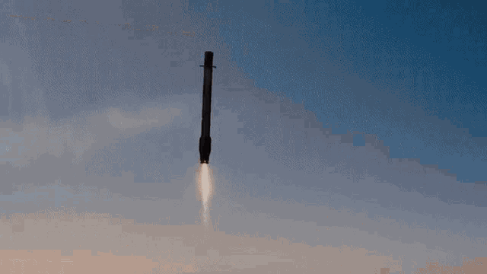
INTRODUCTION
The capstone project aims to predict the successful landing of the Falcon 9 first stage.
SpaceX promotes Falcon 9 rocket launches on their website, priced at $62 million, significantly lower than competitors' costs of over $165 million, largely due to the reusable first stage.
Predicting the first stage's landing success enables estimation of launch costs, crucial for competing bids against SpaceX.
Using data science methods, variables like Payload Mass, Flight Number, Orbit Type, Launch Site location, and other factors were examined to gain insights into their behaviors and dependencies, particularly regarding landing success and mission success rates.

Slide 5

METHODOLOGY
Data Collection
APIs
Web scraping using BeautifulSoup library
Data Wrangling
Exploratory Data Analysis
Pandas, matplotlib, numpy, and scipy
SQL
Interactive Visual Analytics
Using Folium map library
Dashboard using Plotly Dash
Prediction Models
SVM
Classification Trees
Regression

Slide 6
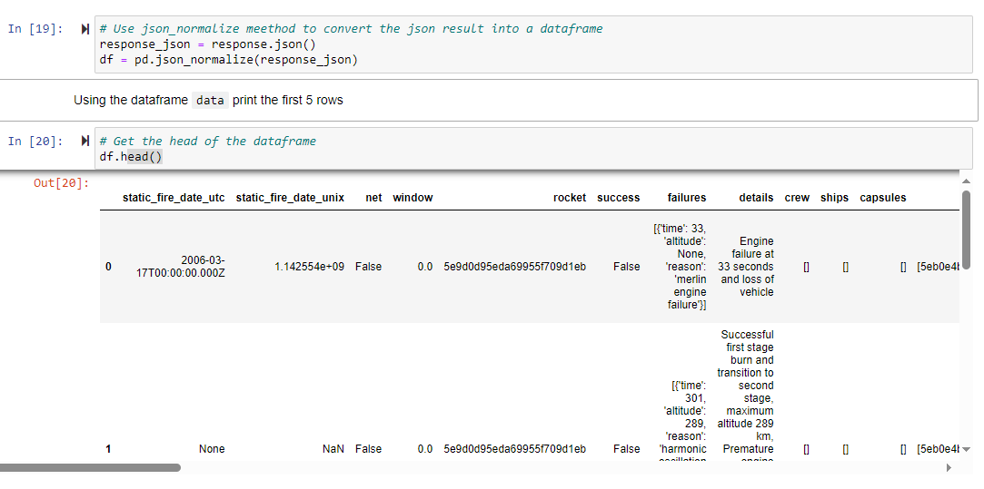
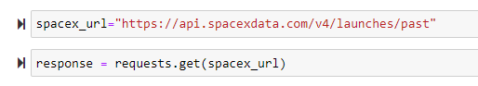
RESULTS
DATA COLLECTION THROUGH API

Slide 7
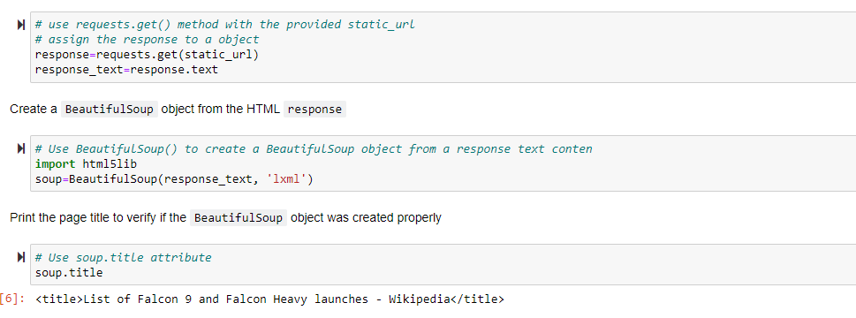
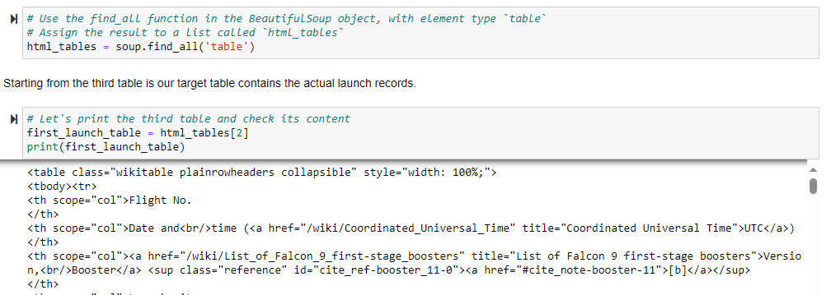
DATA COLLECTION WITH WEB SCRAPING

Slide 8
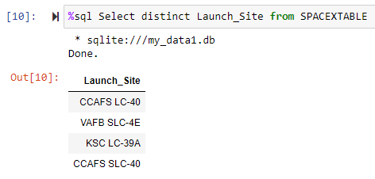
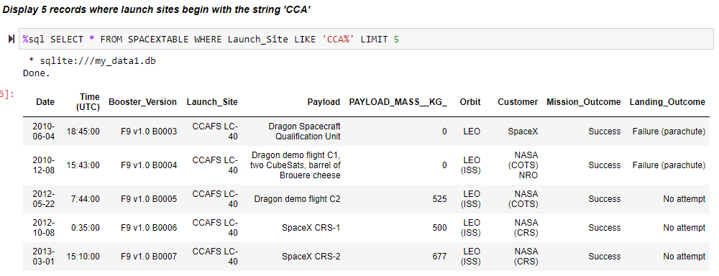
EDA WITH SQL

Slide 9
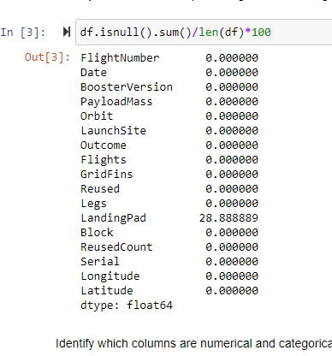
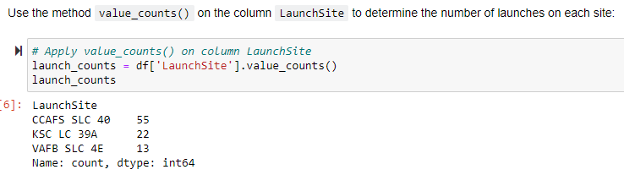
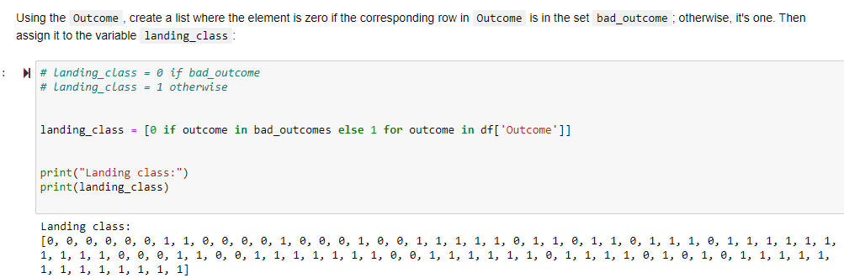
DATA WRANGLING

Slide 10
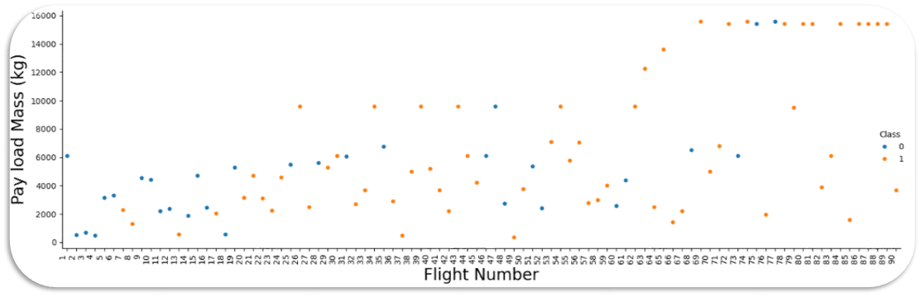
PAYLOAD MASS VS FLIGHT NUMBER

Slide 11
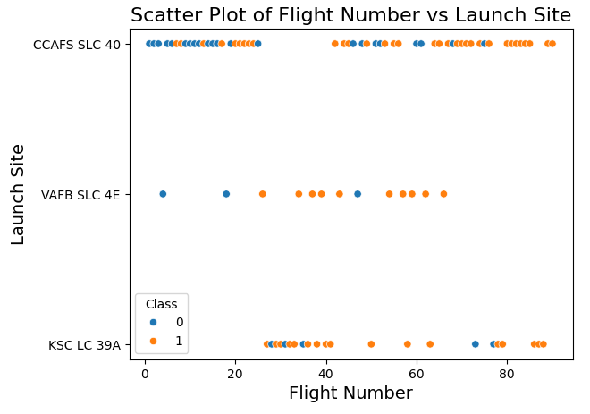
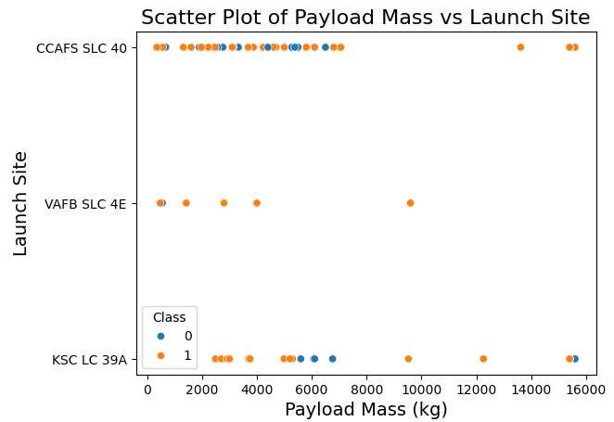
LAUNCH SITE VS FLIGHT NUMBER AND PAYLOAD MASS

Slide 12
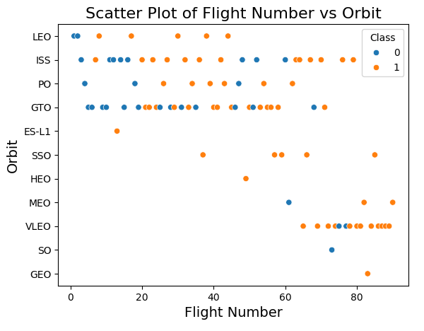
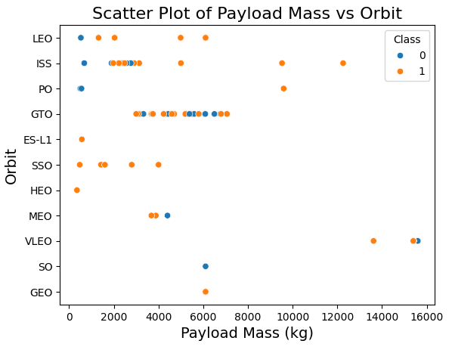
ORBIT TYPE VS FLIGHT NUMBER AND PAYLOAD MASS

Slide 13
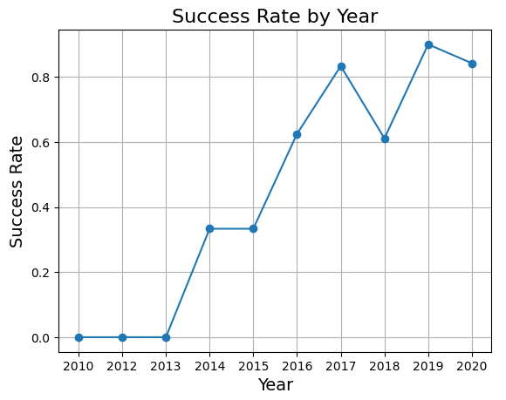
YEARLY SUCCESS RATE

Slide 14
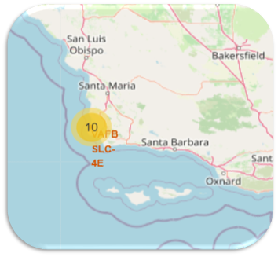
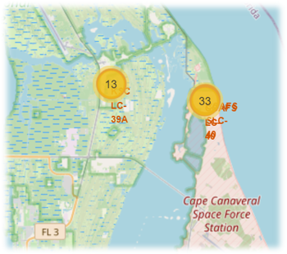
GEO-LOCATION MAP DATA VISUALIZATION
 | Launch Site | Total No. of Launches | Successful Landing of First Stage
1 | CCAFS LC-40 | 26 | 7
2 | CCAFS SLC-40 | 7 | 3
3 | KSC LC-39A | 13 | 10
4 | VAFB SLC-4E | 10 | 4

Slide 15

DASHBOARD
https://github.com/drdataengg/Capstone_Applied_Data_Science_IBM/blob/082882e665b1711d0e0ac46fcc36b2a4bf52a37c/spacex_dash_app.py

Slide 16
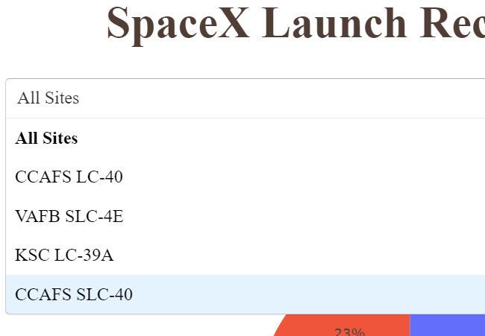
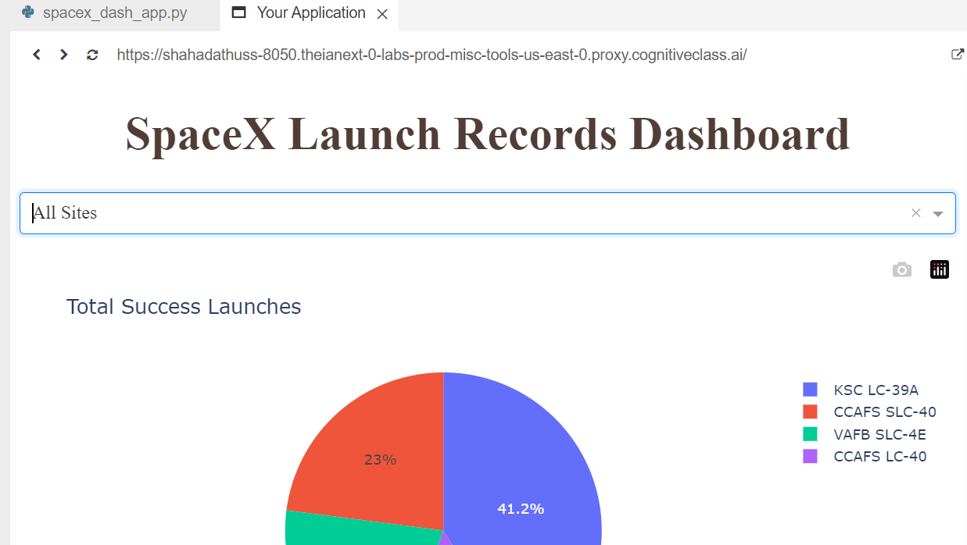
DASHBOARD TAB 1

Slide 17
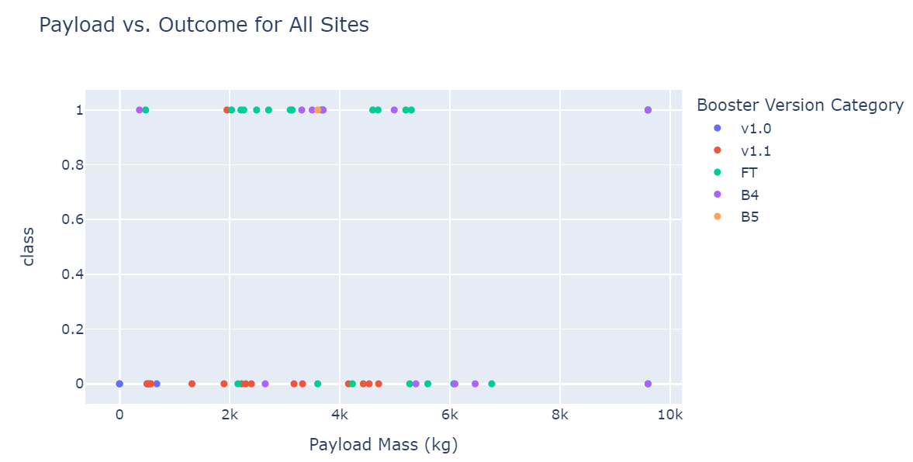
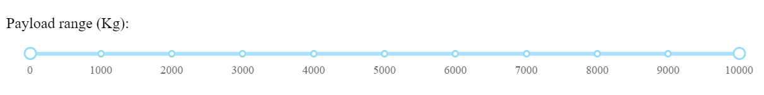
DASHBOARD TAB 2
Payload Range Slider

Slide 18
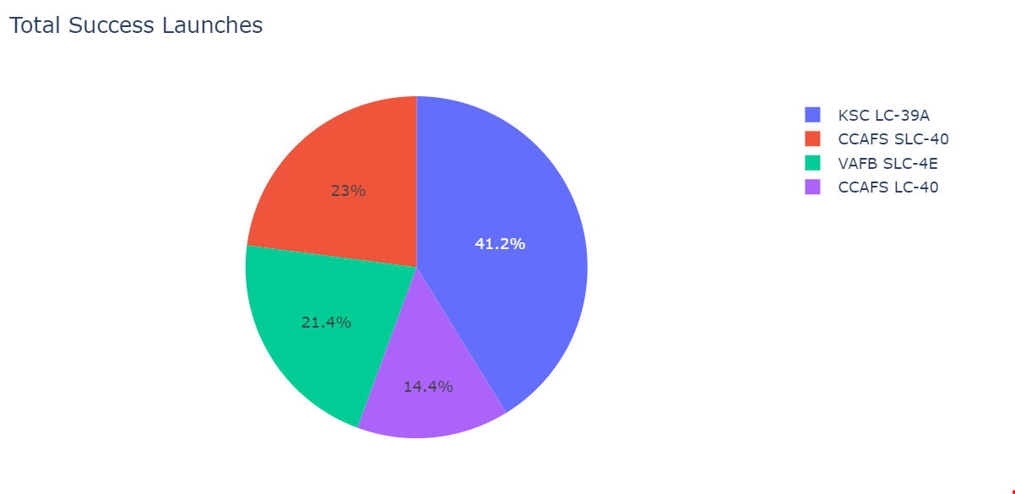
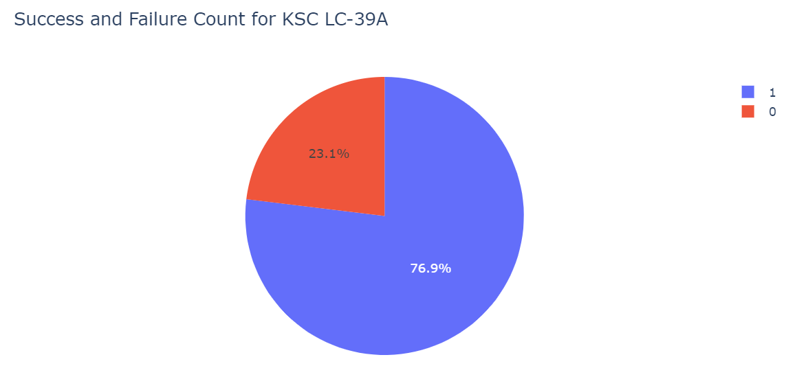
DASHBOARD TAB 3
Launch Site with highest landing success

Slide 19
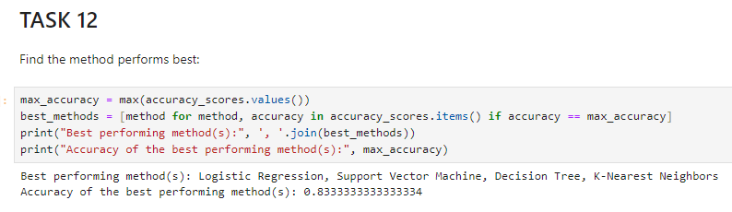
MACHINE LEARNING PREDICTION MODELS
The best method for the prediction models was found to be Logistic Regression, Decision Tree, Support Vector Machine and K-Nearest Neighbors.
They all have an accuracy of 83.33% on the test data modeled by the machine learning algorithms.

Slide 20
DISCUSSION
Increasing flight numbers tend to correlate with a higher rate of successful landings, indicating a potential continuous learning process among engineers involved in the project, building on previous results.
The success rate at each launch site tends to increase as the flight number increases, suggesting a learning curve and improvement in processes over time.
KSC LC 39A exhibits the highest success rate among all launch sites.
The majority of payload masses sent are below 7000 kg.
For payloads exceeding 12000 kg, CCAFS SLC-40 demonstrates a better success rate compared to other launch sites.
SSO orbit shows a 100% success rate, with LEO orbit also demonstrating higher success rates.
Beyond 2013, there is an observed increase in success rate with each passing year.
All four launch sites are situated closer to the coastline, railway, and highway, while being farther from urban areas. This placement ensures safety in case of failure, as launch sites are kept away from densely populated areas. Additionally, proximity to the coast, railway, and highway provides logistical advantages for transportation of heavy rocket or payload objects.

Slide 21
OVERALL FINDINGS & IMPLICATIONS
Findings
The success rates at each launch site tend to improve with increasing flight numbers, reflecting a learning curve and refinement of processes.
Beyond 2013, there is a notable increase in success rates, indicating advancements in technology and operational practices.
The strategic positioning of launch sites away from urban areas, closer to the coastline, railway, and highway, ensures public safety in the event of failure and facilitates efficient logistics for transporting heavy payloads.
Implications
The findings suggest that the aerospace industry is evolving, with a focus on continuous improvement and learning from past experiences.
The observed increase in success rates over time underscores the importance of ongoing research, development, and collaboration within the space exploration community.
The strategic placement of launch sites highlights the significance of safety considerations and logistical efficiency in mission planning and execution.

Slide 22

CONCLUSION
The analysis indicates a positive trend of improving success rates in space missions, driven by continuous learning and refinement of engineering practices.
KSC LC 39A emerges as an effective launch site, while CCAFS SLC-40 shows promise for handling heavier payloads.
Consistent success rates in specific orbits highlight the significance of strategic mission planning.
The observed increase in success rates beyond 2013 reflects advancements in technology and operational practices, emphasizing the dynamic nature of the aerospace industry.

Slide 23
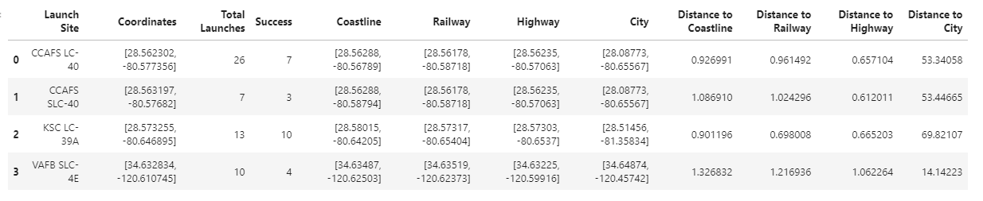
APPENDIX
Calculation of distance between launch sites and other points of interests

